Slide 1

MYLEGION: REPORTS
CSR
Sqdn Current Roster
Roster Updates
Member Dues History
Roster Updates
Paid Members by Sqdn
3x 10 Labels
Renewal Letter
MyLegion Access
Sqdn Health Status
2026
Notes:
MyLegion is a secure website for American Legion and Sons of the American Legion members. View and manage membership information through MyLegion.org.

Slide 2
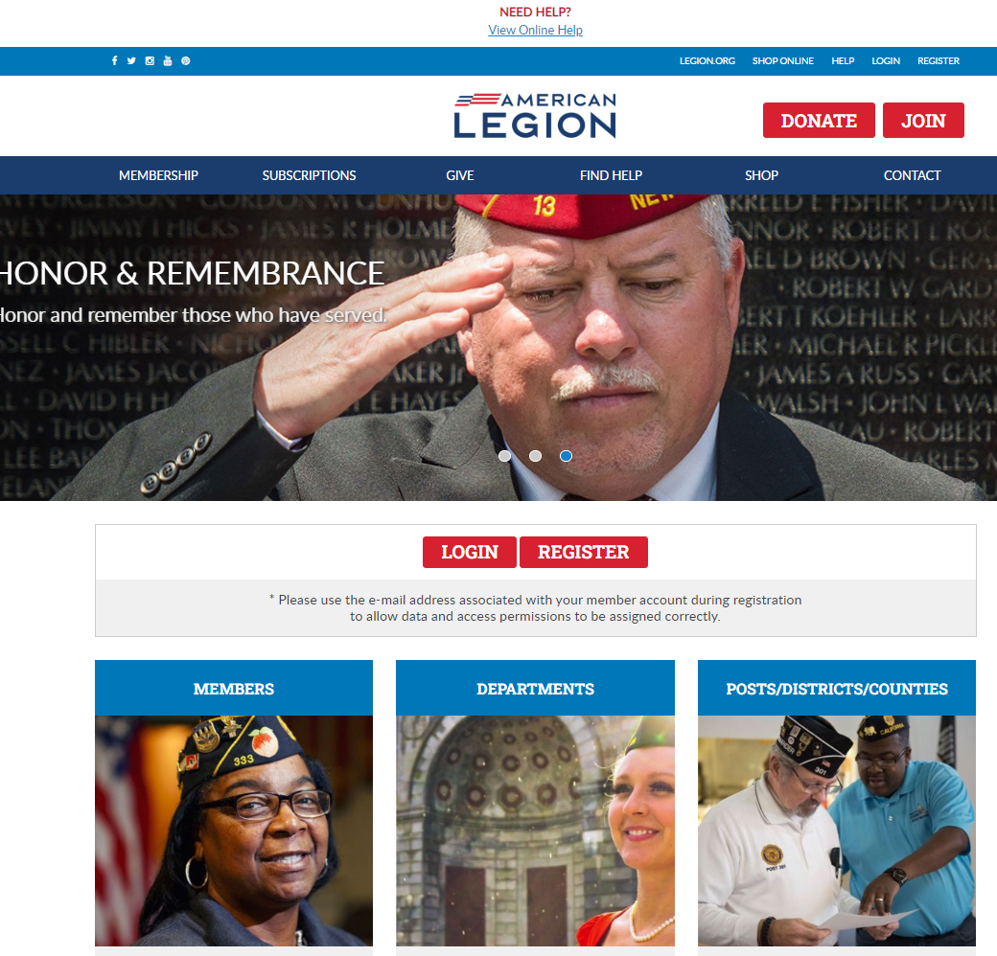

Notes:
Administrative membership management tools are available through MyLegion. Begin by logging into MyLegion.

Slide 3
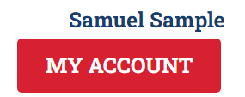
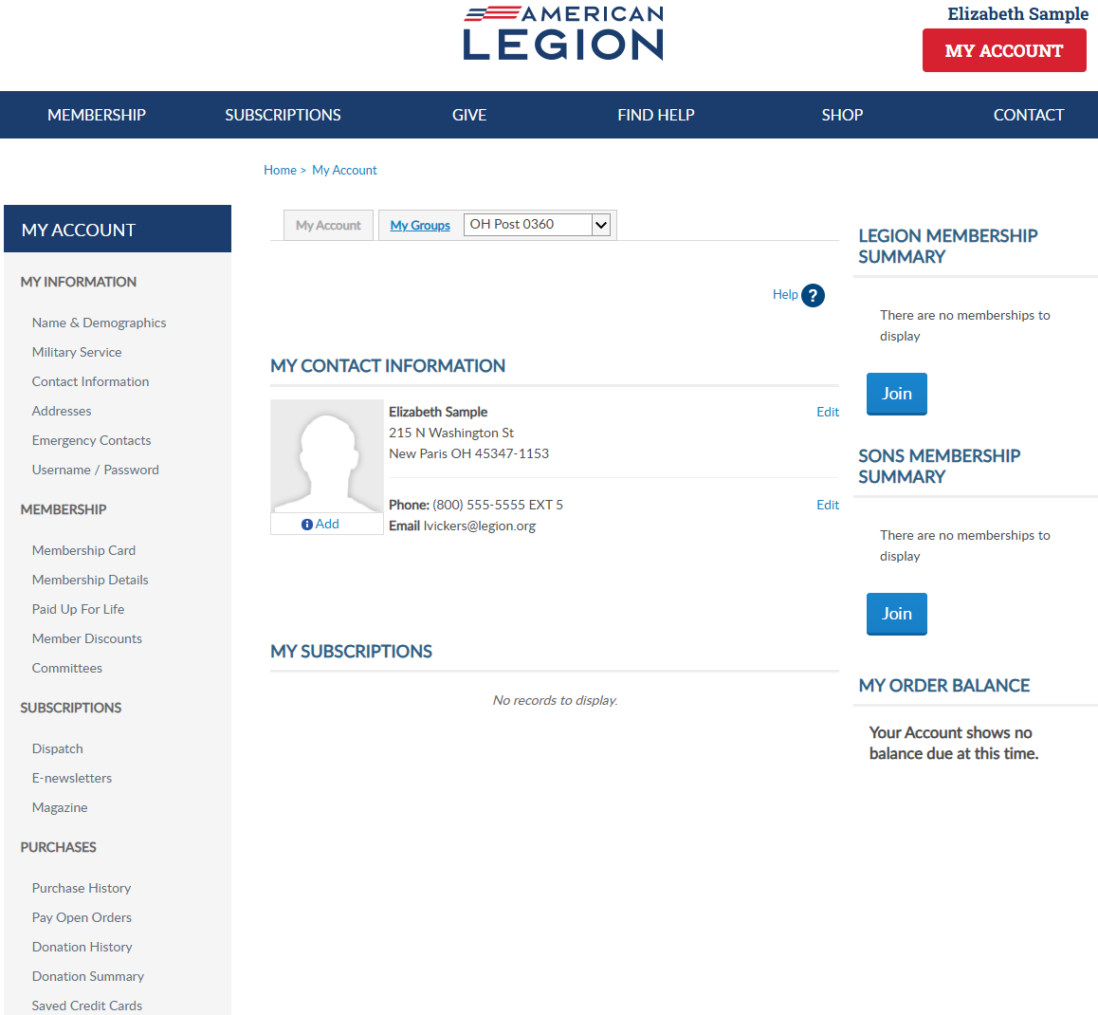

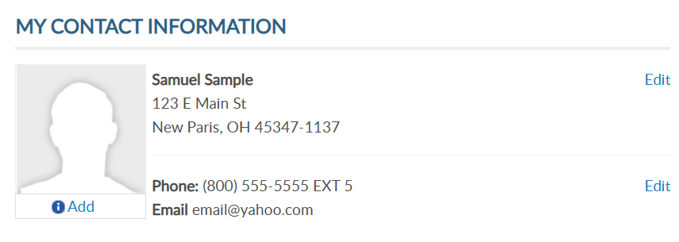
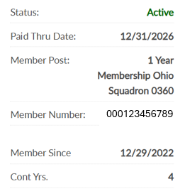
Adjutants, commanders and assigned admins will have a MyGroups menu.
MYLEGION.ORG
No group menu? Contact your department headquarters.
Notes:
My Groups is the administrative side of myLegion available to adjutants and commanders and assigned administrators. <1> If you do not have a My Groups menu and are a current adjutant or commander, contact your department headquarters.

Slide 4
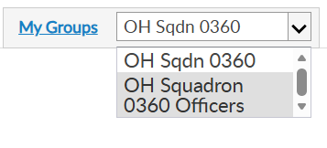
MY GROUPS
Adjutants and Commanders
Post, Squadron, District, County, Dept, Detach
Legion has LGN and SAL
Officer Groups: view only
Select group to transition to the admin side of myLegion.
Notes:
Son’s leadership have access to 2 groups; Sons of the American Legion membership and an officer group. Officer groups are view only. All officers are reported through department headquarters.
This member is a squadron adjutant.
<1> Clicking on the group will navigate you to the administrative side of MyLegion, group profile.

Slide 5
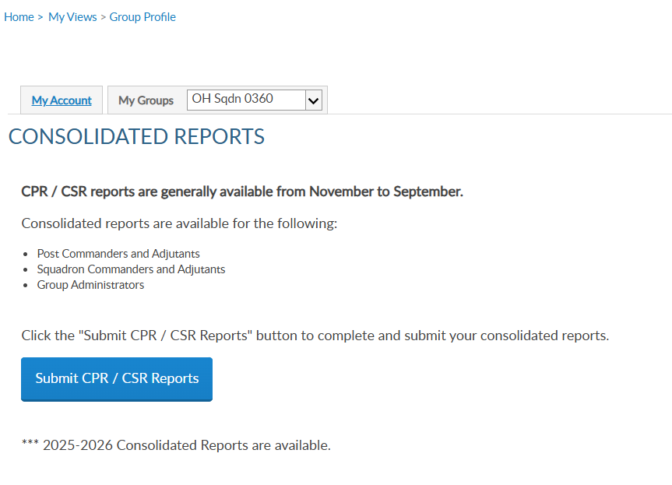
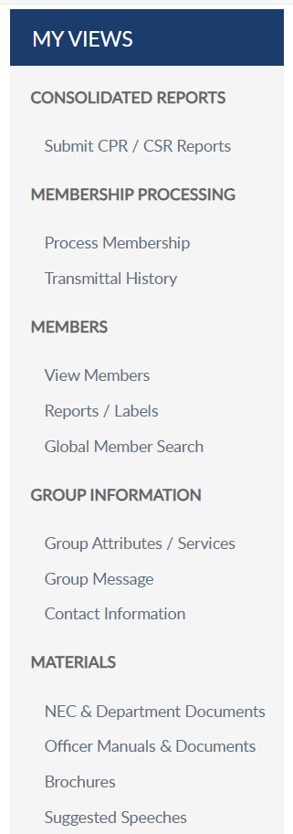

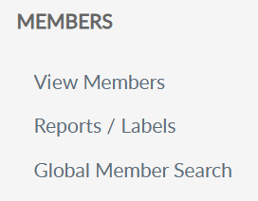
REPORTS
Notes:
MyLegion reports are found on the left menu. Consolidated reports also display on the main landing page dashboard. To submit or view a consolidated report, select “Submit CPR/CSR Reports.

Slide 6
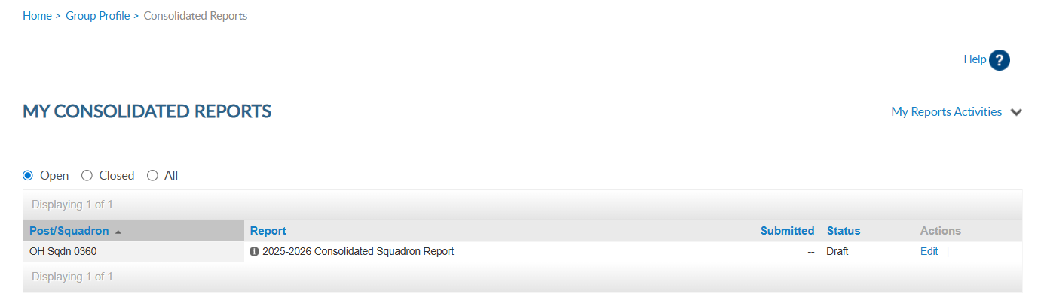
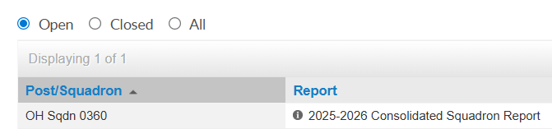
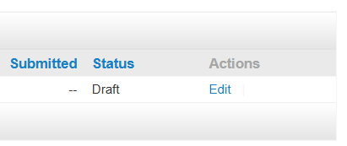
Do not submit a paper form if submitting online.
Departments have access to online reports.
Notes:
There are 3 view areas in consolidated reports. Open, Closed, and All.
Open reports are available to enter data while in draft status. There is only one open report for the reporting year. When available, you can edit the report until the report is submitted or until the final submission date.
To enter information in the report, click Edit. If you submit online, do not mail a paper form. The department has access to submitted report data.

Slide 7
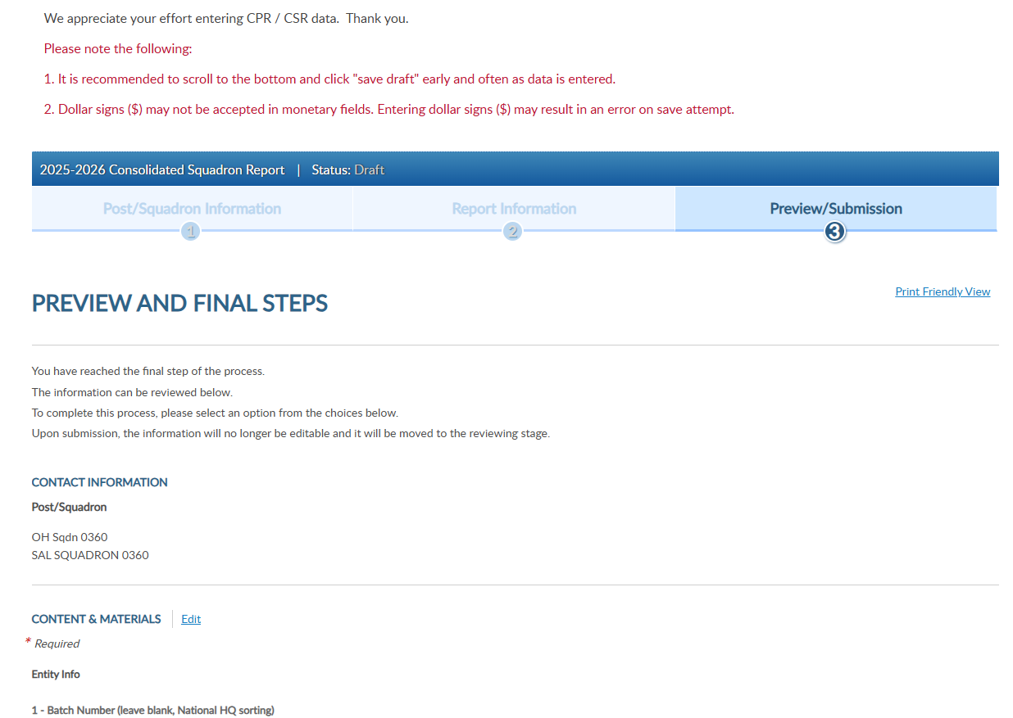
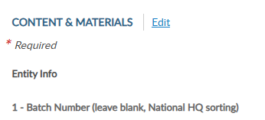
Notes:
Click edit to open the fillable form.

Slide 8
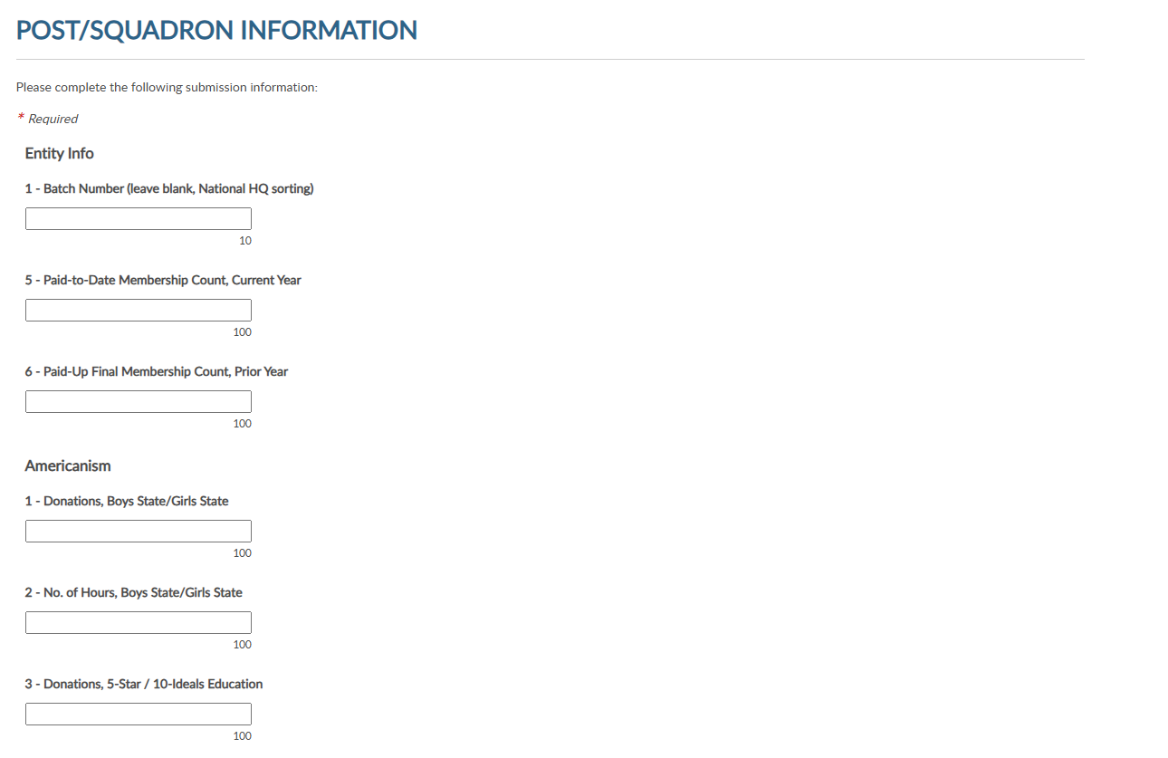
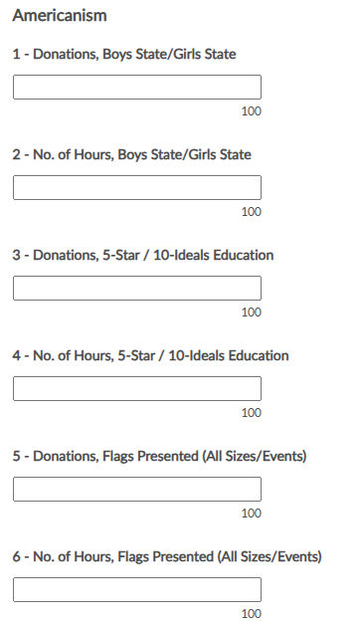
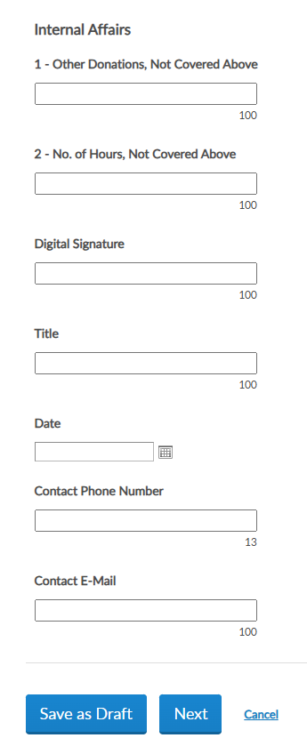

Notes:
The report questions will be grouped by area. The small number indicates the total number of characters allotted for the field.
Scroll down to continue with questions until completed or you can save the draft and finalize before the final submission date. These buttons are located at the bottom of the form. <1>

Slide 9
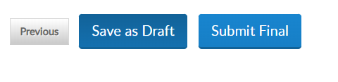
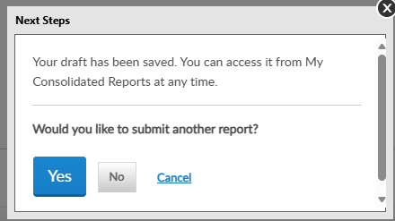
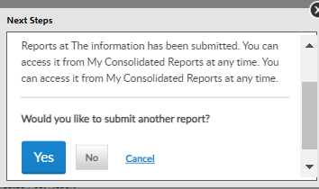
Your draft has been saved. You can access it from My Consolidated Reports at any time.
The information has been submitted. You can access it from My Consolidated Reports at any time.
Notes:
Selecting Next brings up options to Save as Draft or Submit Final. Submitting as Final will close the report for editing. <1> Click any selection to continue.

Slide 10
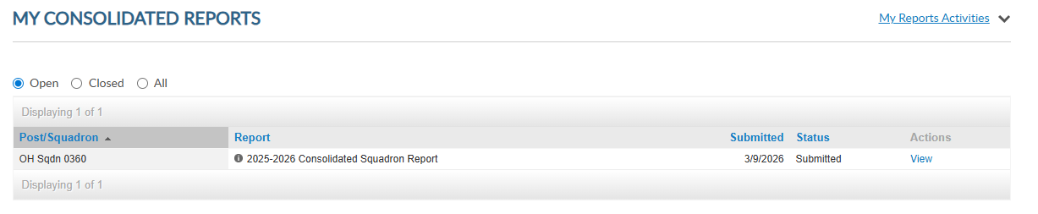
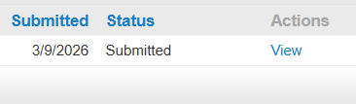
Submitted reports cannot be edited.
To re-open the report, contact myLegion@legion.org
Notes:
Submitted reports will remain in the Open area with a submitted status until the report is closed for the year.

Slide 11
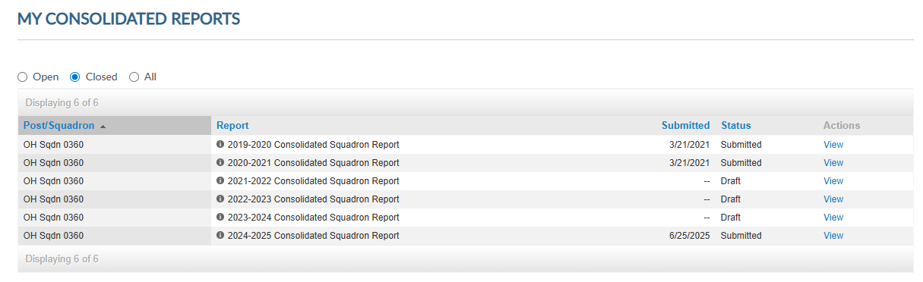

Closed reports cannot be opened for editing. You can view reports from 2019-2020 to present.
Notes:
Closed reports do not display open reports and are view only. Use the navigational tools to view next page or full list. Closed reports in draft mode are unsubmitted and are no longer available to edit and submit.

Slide 12
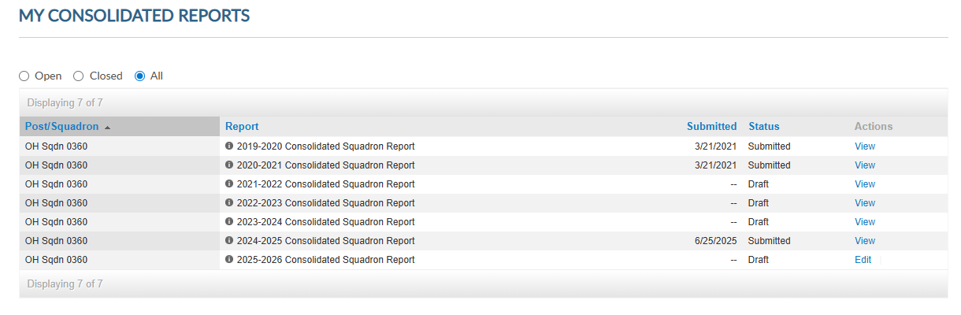

All section displays open and closed reports. Click view to open and print reports. Edit is only available to open reports.
Notes:
The All section includes open and closed reports. You can view and print all reports. Click view to open and print.

Slide 13
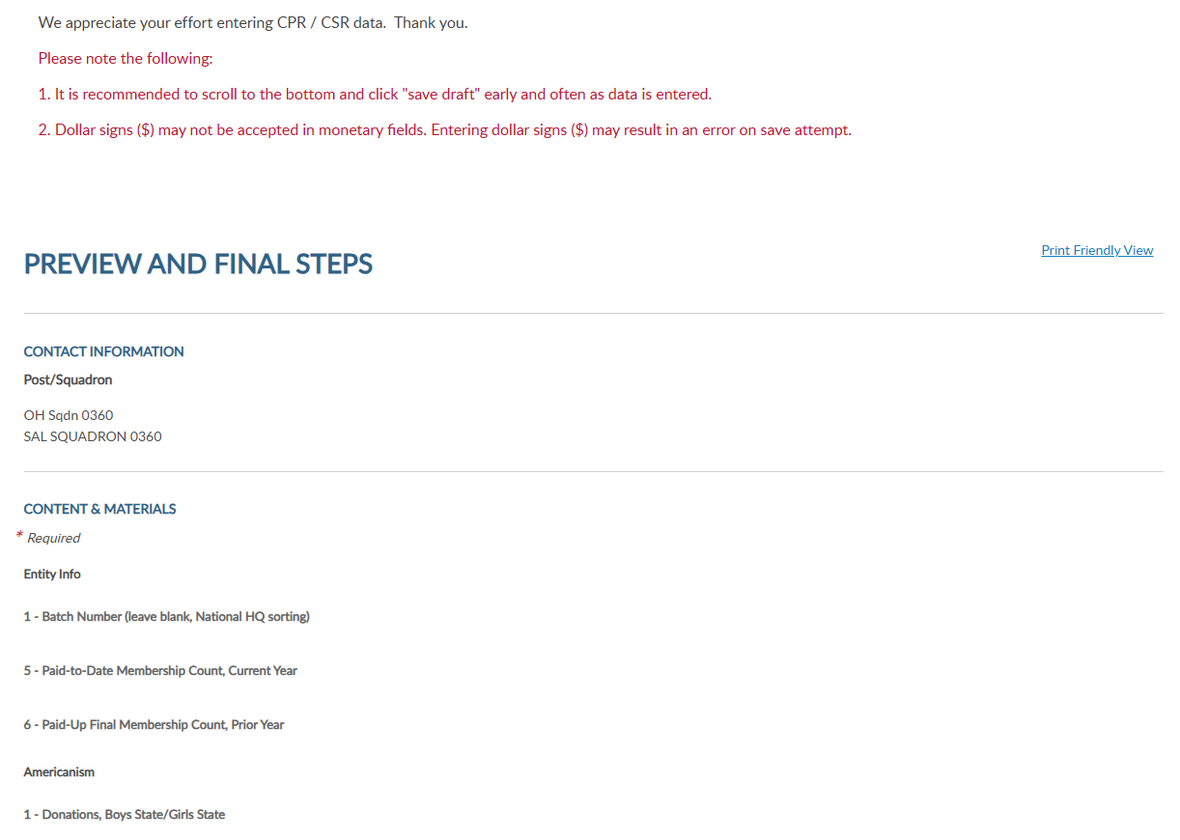

Notes:
Select Print Friendly This allows you to print the report as a PDF document.

Slide 14
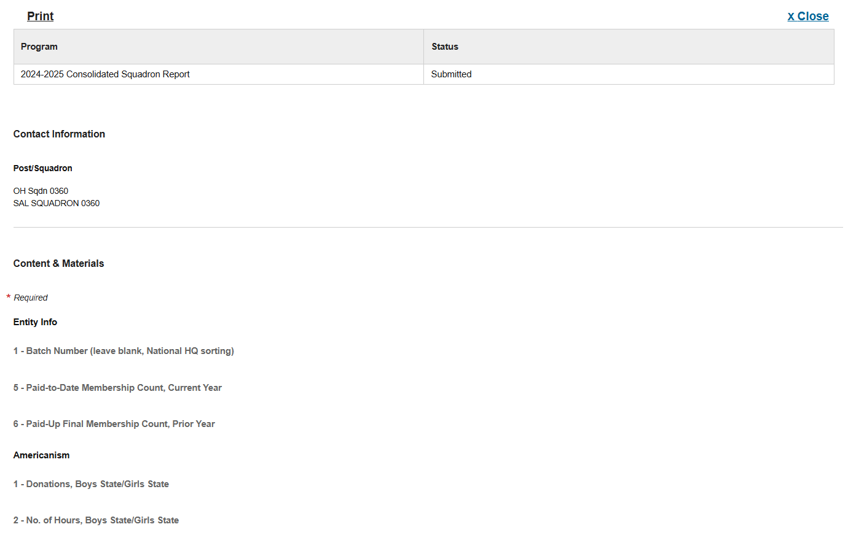
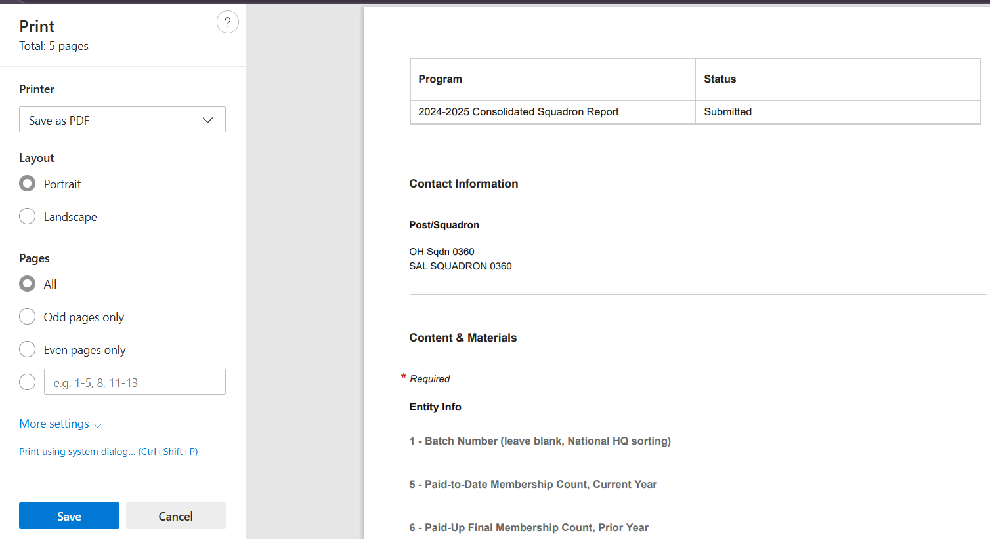

Notes:
Select print to open as a PDF document. From the print window you can save the document or print.

Slide 15
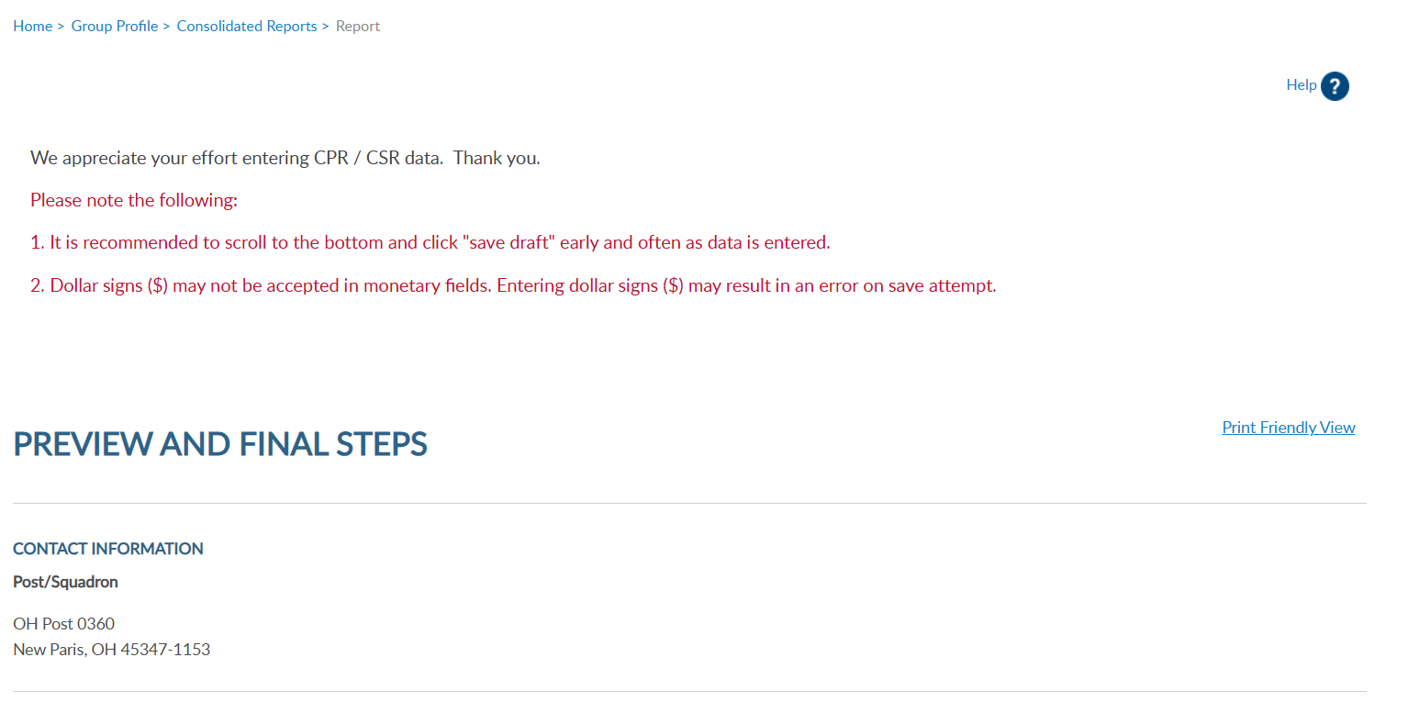

Notes:
Click on Group Profile to return to group administrative window.

Slide 16
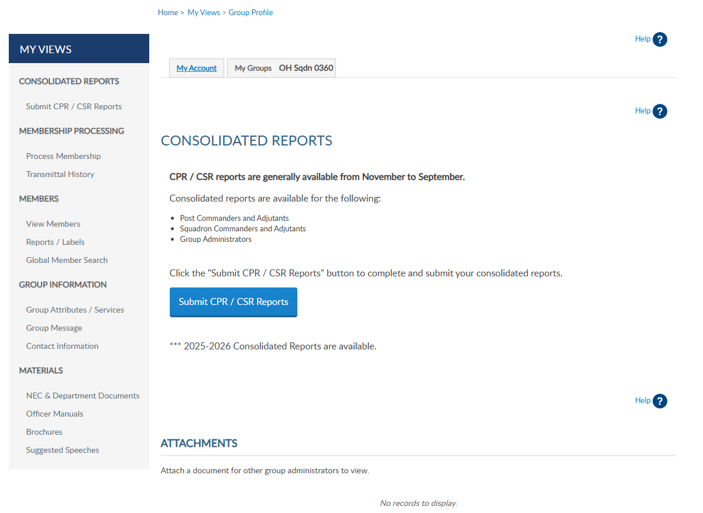
Notes:
Membership listings, roster updates, members renewed online, and mailing labels are available through Reports/Labels.

Slide 17
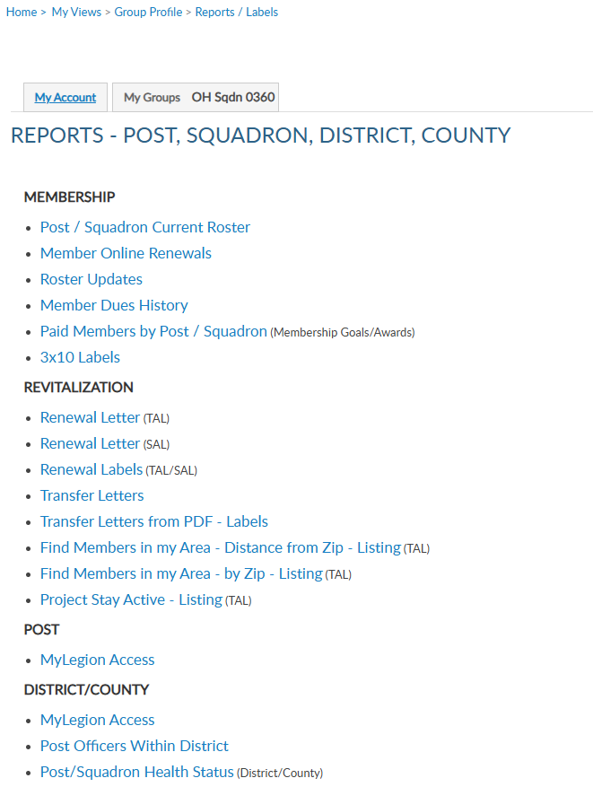
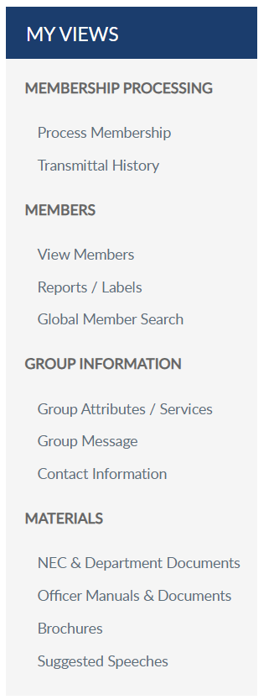
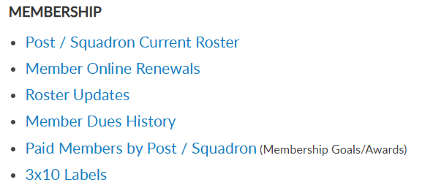
Notes:
Click on the report or letter to proceed. Let’s start with the post/squadron current roster.

Slide 18
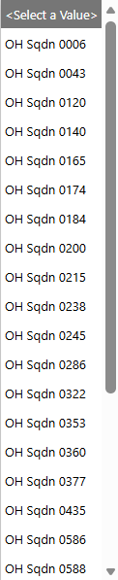
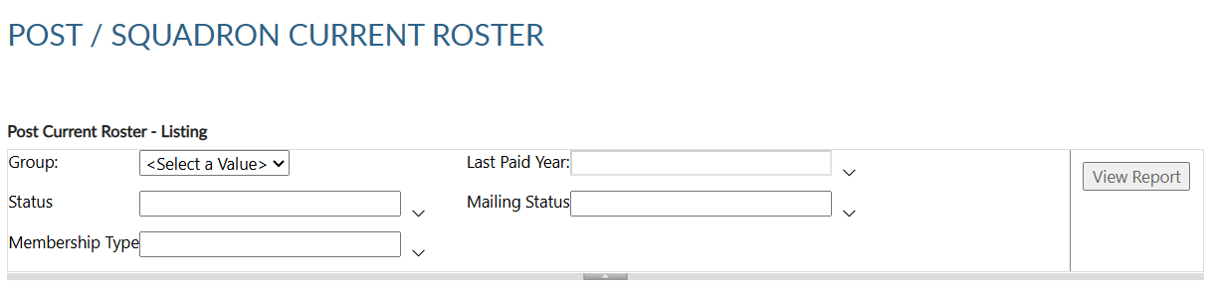

CURRENT ROSTER
Current roster includes members who are current, expired, and deceased.
District and county groups list includes assigned squadrons.
Notes:
This current roster report only includes current members of your squadron. Members who have transferred out are not included in current membership. To view members who have paid to your squadron, generate a Paid Members report.
All reports are created using data filters. Filtering menus allow flexibility to the data included in the roster. <1> The first field for all reports begins with selecting a squadron from the pulldown menu. District and county access will provide a list including all squadrons assigned to the district or county.

Slide 19
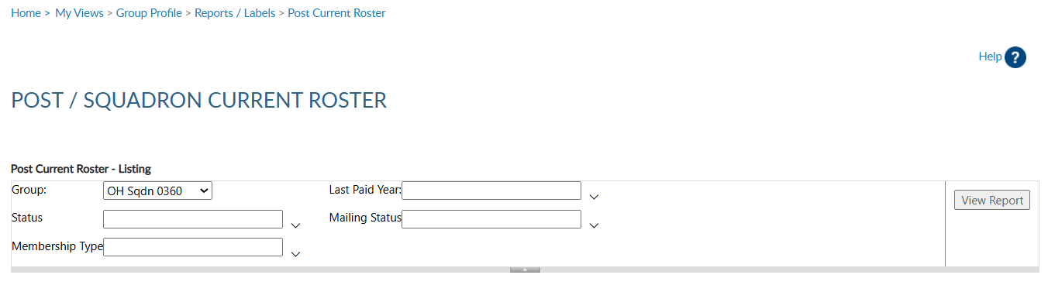
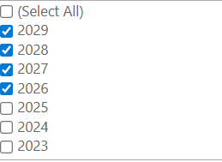
CURRENT ROSTER
Check desired LPY and all greater.
Notes:
Next select last paid year. Last paid year on a member’s record will list the year of future paid years if applicable. Multi-year renewal is available for Legion members only.
When selecting last paid year, keep in mind any members with a future last paid year, are, by definition, paid for the current year..

Slide 20
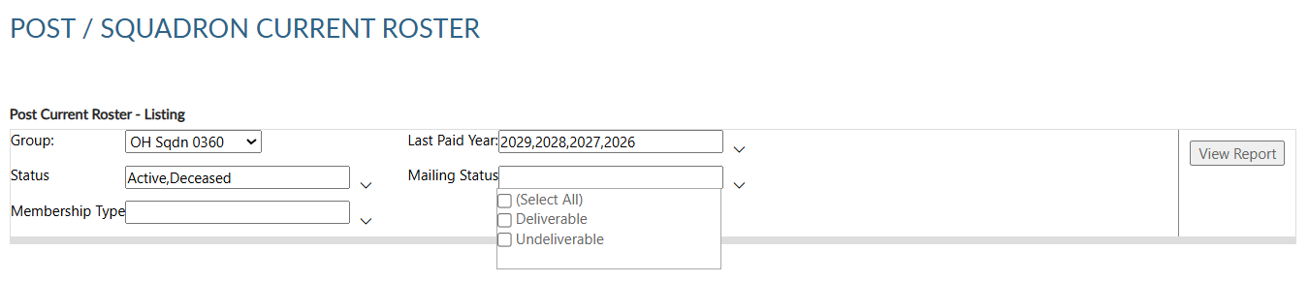


Notes:
Status includes active and deceased. Deceased members will remain on the roster and can be filtered out by selecting active only.
The next filter is mailing status. Mail status lets you know if the mailing address on file is good or flagged as undeliverable. Members with undeliverable status do not receive renewal notices or any mailings from National Headquarters. Contact those members, if possible, to collect a valid mailing address and update. Updating an address that is marked as undeliverable will remove the flag. If a member states the address on file is good, contact National Customer Service to remove the flag.

Slide 21
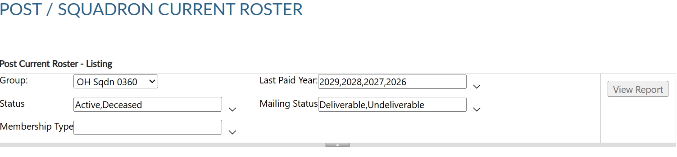

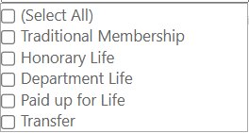
Not all membership types apply to Sons of the American Legion.
Notes:
Membership type includes traditional 1-year renewal, honorary life, department life, paid up for life and if the member is a current transfer. Not all apply for SAL.
<1> After all data fields have been set, click View Report.

Slide 22
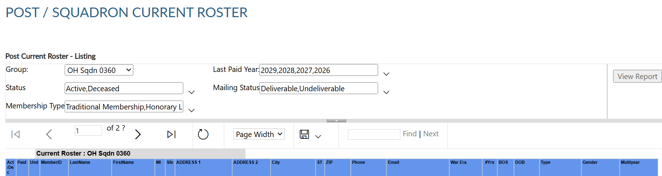
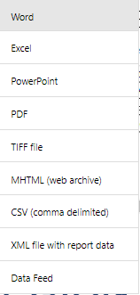
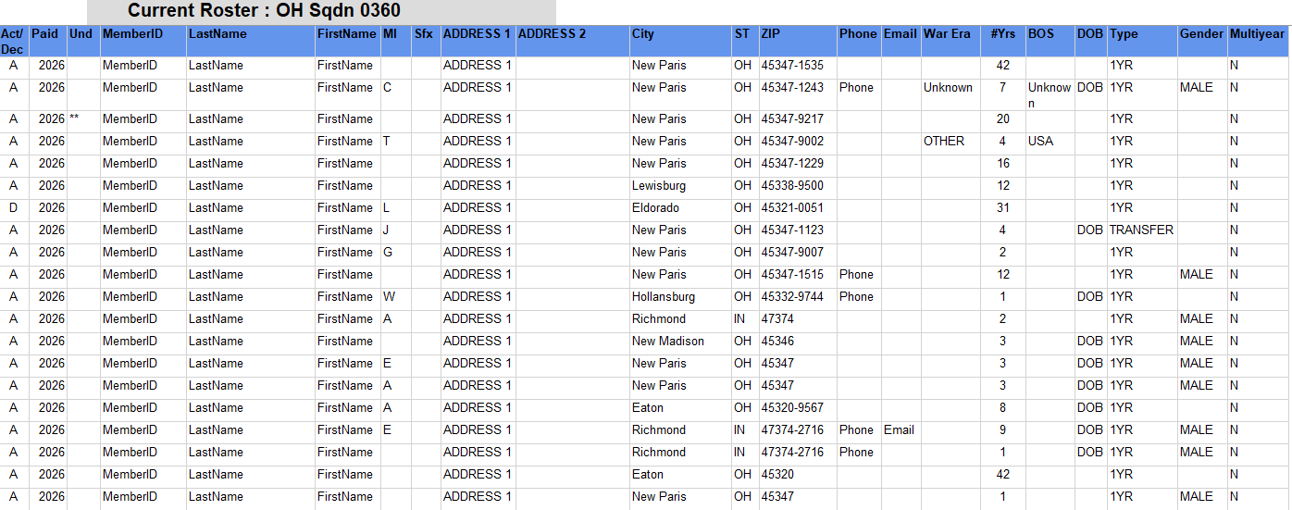
Active/Deceased
Last Paid Year
Undeliverable Address
Member ID#
Last Name, First Name, MI, Suffix
Address 1, Address 2
City, State, Zip
Phone, Email
War Era/Conflict
Continuous Years
Branch of Service
Date of Birth
Member Type / Gender
Multi-year Renewal
Notes:
The roster includes status, paid year, contact information, conflict, continuous years, branch of service, date of birth and membership type. Using the export Icon, export to an Excel document. <1>

Slide 23
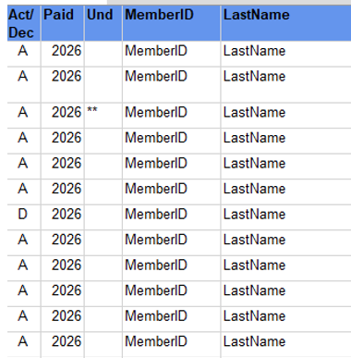
Notes:
The total at the bottom. The report includes current members only. . Members who have transferred out are not included in current membership.
<1> The members included in the report are deceased, undeliverable, expired and current members.
Undeliverable addresses are indicated by asterisk. Members with an undeliverable address do not receive renewal notices or other mailed publications. All undeliverable addresses should be reviewed and updated through your department headquarters and national customer service.

Slide 24
Notes:
Members that renew online can be identified using the Member Online Renewals Report.
Click on the blue hyperlink to begin the members online renewal report.

Slide 25
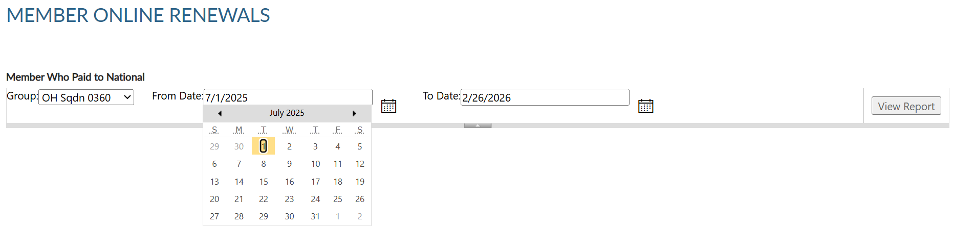
Notes:
Group selection is required. Date range selection is updated by clicking on the calendar icon. <1> Use the left and right arrows to navigate by month and year. Click on the date in the calendar to set. <2> Click View Report to generate listing.

Slide 26
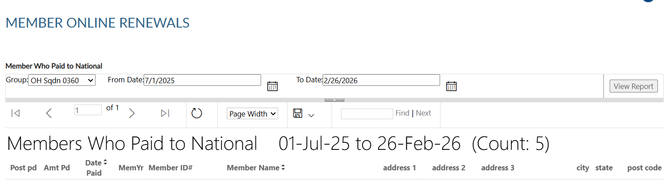
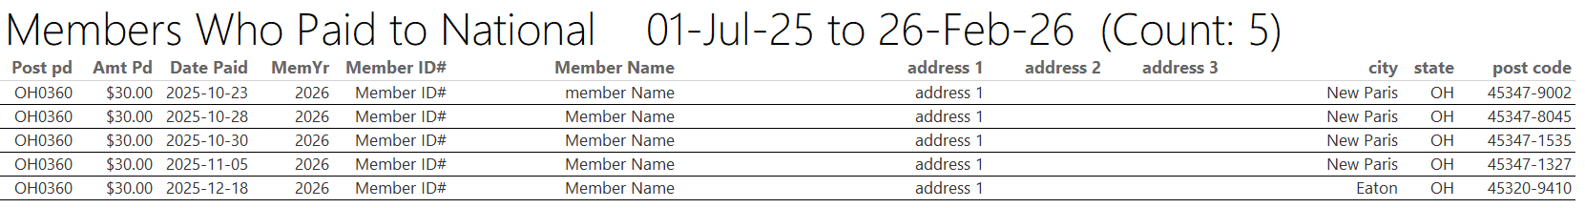
Notes:
This report provides the total count with names, member id#, date and renewal year.
<1> The export icon is used to print and save reports. Reports are not saved within the report writer.

Slide 27
Squadron dues collected per member are determined by what is reported on the Squadron Data Report (SDR).
National Finance Division sends per capita to the department for squadron distribution.
Member online renewal is not available if squadron dues do not cover minimum of National + Detachment.
Notes:
The report shows the total amount of dues collected by the member, as reported on the annual post data report.
<1> When a member renews online, National collects post dues and sends all others to the department to distribute.
<2> If the post dues do not cover the minimum of national plus detachment, online renewal will not be available and result in an error message if the member attempts online renewal.

Slide 28
Notes:
The next report is Roster Updates. This report helps identify members who have transferred in and out of your squadron, new members and other updates made on the member record.
Select the Roster Updates blue hyperlink to begin.

Slide 29
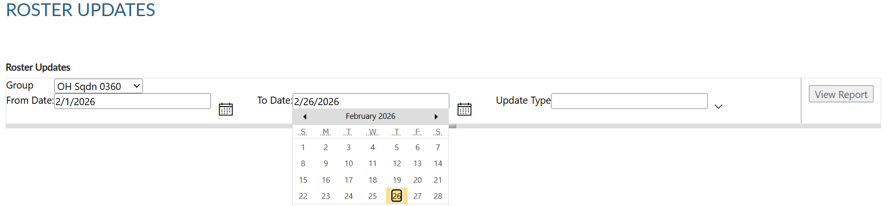
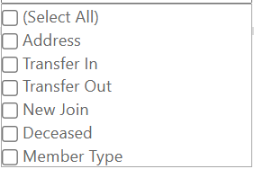
Updates to member information for address, deceased status, transfer information and new members (new join).
Notes:
Select your group and date range using the calendar icons. <1> Select update type or all. After all filters are set View Report to generate. <2>+

Slide 30
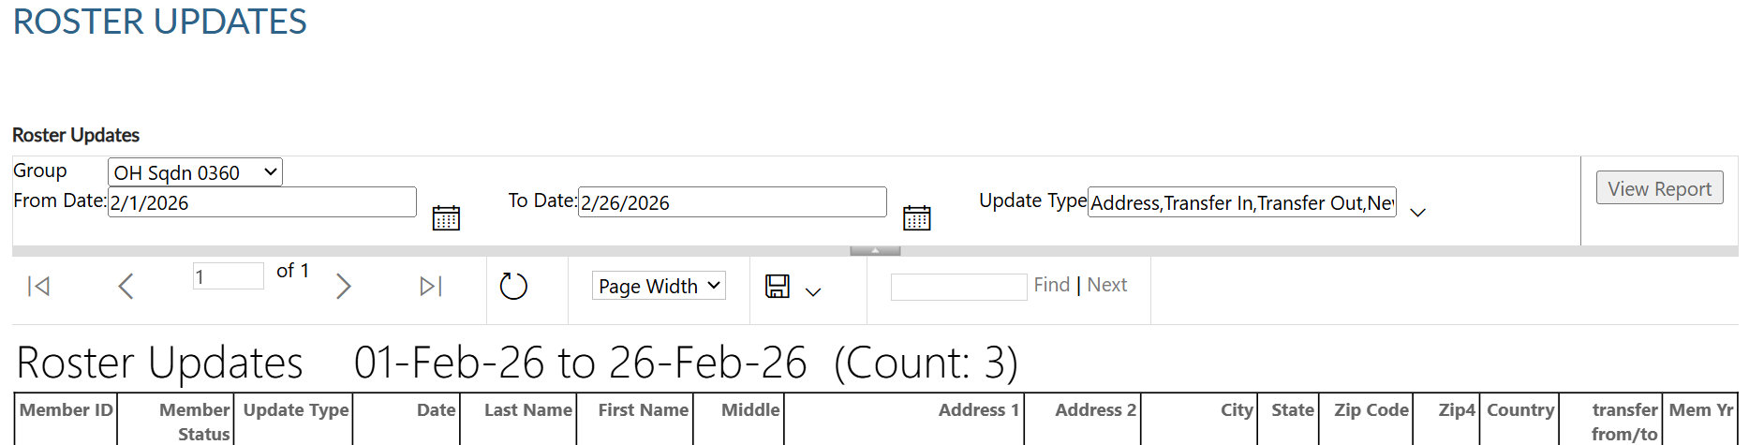
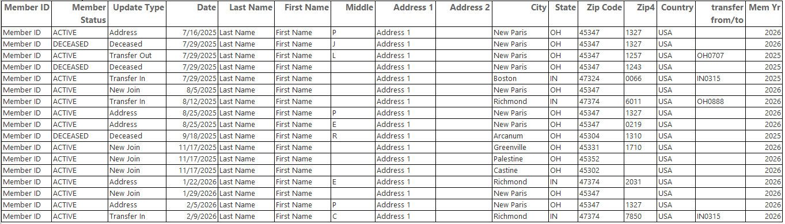
ROSTER UPDATES
(Count 21)
Notes:
To print or save, export to an Excel Document or PDF.

Slide 31



Notes:
The report gives you information on updates made to the member record. Notice transfer information includes to and from information. Members who transfer out of your squadron no longer appear in current roster or current membership reports. Paid members who transfer out will be included in the Paid Members report.

Slide 32
Notes:
Dues history report displays payment information from 2011 to present.

Slide 33


Displays member payments from 2011 to current.
123456789
Notes:
Enter the 9-digit membership number and SAL as the organization and click View Report. Use the export icon to save or print. <1>

Slide 34

Notes:
Payment history includes 2011 to present. If more payment information is needed, contact your department headquarters. Departments can work with national headquarters to view archived data.

Slide 35
Notes:
The Paid Members report is the report corresponding with Detachment membership reports. It includes all members paid for the current year, even if they transferred out.

Slide 36

Paid members for the current membership year. Includes members who paid yet transferred out.
LEGION ONLY
Notes:
Enter SAL as the organization, group, and last paid year. Click View Report to generate.<1>

Slide 37


Notes:
Export the report to save and print.

Slide 38

Notes:
This report includes members who have paid to the squadron, even if transferred out. It also identifies the renewal type and batch number. The paid members’ report will correlate with detachment membership goals reports.

Slide 39
Notes:
3x10 labels produce a 30 per sheet label that fits Avery 5160 or any 30/sheet blank labels. Click on the blue hyperlink to set filters and create labels.

Slide 40

30 per sheet mailing labels for LGN and SAL members.
Notes:
Filtering options allows you to define the members included in labels. Deceased and members flagged as undeliverable will be suppressed from mailing labels.
The first step is to select the group. Next, select the last paid year or multiple years. Designate if you want your labels sorted by last name or zip code.
After parameters are set, View Report to continue. <1>

Slide 41


Max A Sample
PO Box 123
Somewhere, OH 45377-2835
Thomas Sample
123 Main Street
Somewhere, OH 45377-2835
Export to PDF
Notes:
The label display is not in 30/sheet format. Send the data to a PDF document selecting the export icon. The export icon is used print and save all reports using the file types in the menu. PDF is the only selection that applies for labels. After you select PDF look for a tab to open the PDF generally located at the lower left of your window.

Slide 42



Notes:
The PDF opens to print labels. Use the print icon to send to your printer.

Slide 43

Notes:
A renewal letter is available to reach out to expired members.
You can also create labels for renewal letters. Go to Renewal labels and use the same criteria used for letters.

Slide 44

RENEWAL LETTERS
Pre-written custom letter inviting expired members to renew. Create labels for your letter using the same filter criteria.
Notes:
Creating the letter begins with filters. Select the group first. This populates the contact’s name and title with commander information. These fields can be modified by typing new text in the fields.

Slide 45



RENEWAL LETTERS
Pre-written custom letter inviting expired members to renew. Create labels for your letter using the same filter criteria.
Notes:
Enter last paid year or multiple years and sort option. Only expired years will be available. Click View Report to generate. <1>

Slide 46

Gary Example
We want you back!
Notes:
The personalized letter generates. Letters need to be exported to print. Using the export icon, export to a PDF. <1>.

Slide 47


Notes:
The letter is personalized using member and post or squadron information including dues and dues remittance address.
<1>The bottom of the letter includes a remittance slip with dues amount and member information. If there is contact information missing, a line is provided for the member to complete and return with dues.

Slide 48
Notes:
The renewal letter has label options. When creating labels for a renewal letter, use the same filter options.

Slide 49
LEGION ONLY
Notes:
Transfer letter, Find Members in my Area and Project Stay Active are Legion only.

Slide 50

Notes:
Monitor who has access to your group in MyLegion using the MyLegion Access report.

Slide 51


MYLEGION ACCESS
Monitor who has access to your group in MyLegion. Adjutants and Commanders have access by default.
District and county groups list includes assigned squadrons.
Notes:
The group menu displays a list of posts or squadrons depending on your group. Click View Report to generate.

Slide 52



Notes:
Adjutants and Commanders will have permission by default. To update permissions, search the member record and go to Assign Group Permissions. Only adjutants and commanders can assign and remove group permissions.

Slide 53
POST ONLY
Notes:
District and County reports include a post officer report. This report produces post officers only.

Slide 54
Notes:
District and County reports include Squadron Health Status.

Slide 55


Monitor post and squadron membership processing and consolidated reporting.
Notes:
Monitor membership processing and consolidated reporting for squadrons in your group. Group selection will include district and county groups. Enter your group, last paid year and View Report. Export the file to save or print.

Slide 56

Notes:
The list provides squadrons with their last transmittal date, number of unpaid members, consolidated report status, and address information.

Slide 57

Notes:
Online help is available from the top Menu “Find Help”.
Step by step instructions, videos and training presentations will assist with how to manage groups in MyLegion.

Slide 58

Online Help
Notes:
Step by step instructions, videos and training presentations will assist with how to manage groups in MyLegion. My Groups instructions include managing membership, online, membership processing, reports and all other administrative tasks.

Slide 59
MYLEGION SUPPORT
MyLegion@legion.org
833.253.9995
Monday – Friday
8:00am – 4:30pm
(Eastern)
The American Legion National HQs
5745 Lee Road
Indianapolis, IN 46216
Contact your MyLegion support team to assist with any questions or tools on your MyLegion account.
Notes:
Contact your myLegion support team to assist with questions and tools for MyLegion. Email mylegion@legion.org or call 833-253-9995 Monday through Friday.

